Slide 1
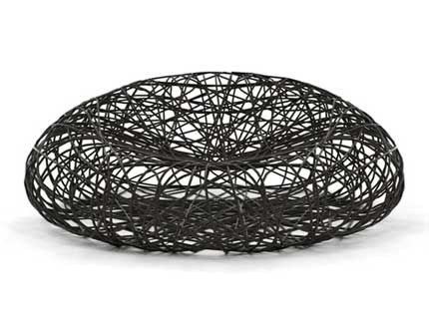
COMP806: Software Architecture
Introduction
Dr Roopak Sinha and Dr. Quan Bai

Slide 2
Outline
Me and this course
You
Course structure and requirements
Survey questions
718304: Software Architecture

Slide 3
About me
Dr Roopak Sinha
  Ph. D, University of Auckland
Senior Lecturer and MSOC Academic Leader @ AUT
  Previously: INRIA, Grenoble, France; The University of Auckland
Research interests
  Formal methods for software engineering
    Modelling
    Verification
    Algorithms
  Intelligent transportation systems, industrial automation, factory automation, safety-critical systems, home automation software
  Correct-by-construction design of large scale embedded systems.
718304: Software Architecture

Slide 4
Contact Information
Contact:
  Email: rsinha@aut.ac.nz
  Room: WT704B (drop in)
  Phone: (09) 921 9999 Ext: 6256
718304: Software Architecture

Slide 5
Please introduce yourself
Who are you?
Your background?
What’s your future plan?
Why did you choose this paper?
What do you want to learn from this course?
718304: Software Architecture

Slide 6
Software Architecture
This is a Software Engineering paper
Who should take this paper?
  Interested in software engineering
  With software development and software engineering background
718304: Software Architecture

Slide 7
Learning Outcomes
On successful completion of this paper students will be able to:
  Investigate and contribute to the research body of knowledge in Software Architecture
  Understand the key factors and critically assess the issues that come into play in the development of large-scale software systems.
  Independently select or design architectures for complex software systems and clearly document non-trivial software architectures.
  Critically evaluate different software architectures and analyse their advantages and disadvantages.
718304: Software Architecture

Slide 8




How will the course run?
406704: Program Design and Construction.

Slide 9
Lectures
Tuesdays 2:10pm – 4:00pm
If you need a bathroom break or whatever, just stand up and walk out (and please come back soon)
Ask questions at any time
Lectures are the main way that material will be covered.
Anything that we talk about in the lectures may be covered in the exam, even if it isn’t on the slides
718304: Software Architecture

Slide 10
Lecture Plan
2-hour lectures every week
  1-2 guest lectures (TBA)
  Week 4 will be reserved for elevator pitches of the project proposals
  Weeks 11/12 will be reserved for final presentations and demonstrations
718304: Software Architecture

Slide 11
Assessment
60% Assignments, 40% exam
The assignment will be a group project
Let’s look at the project specifications.
718304: Software Architecture

Slide 12
AUT Online Resources
Check out Blackboard/AUTonline for:
  Announcements
  Course materials by week
  Assignment
  Feedback
  Marks
  (Basically everything)
718304: Software Architecture

Slide 13
Survey questions
These questions are just for helping me to know your knowledge background and how to organise this paper better. Please answer these questions based on your understandings.
718304: Software Architecture

Slide 14
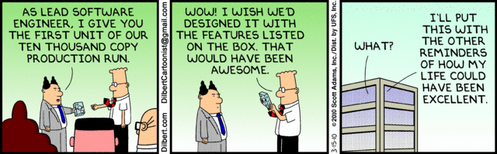
Software Development
Dr Roopak Sinha and Dr. Quan Bai

Slide 15
Outline
Code, program, software and system
Software development activities
Software development process models
718304: Software Architecture

Slide 16

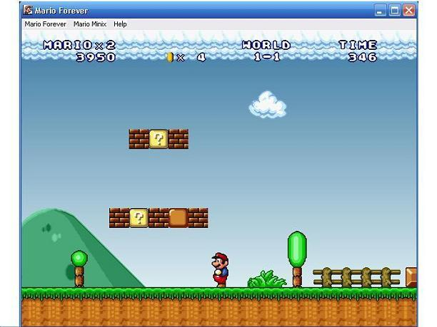

Do you enjoy programming?
Is developing software easy?
Dr Roopak Sinha

Slide 17
Code, Program, Software and System
Code == Program == Software == System??
“A computer program is an artefact that describes computations and/or actions that are to be carried out by a computer.” http://en.wikipedia.org/wiki/Computer_program
“A computer Software is a collection of programs and data held in the storage of a computer for some purpose. Software can implement a computer program; such software performs the function of the program it implements, either by directly providing instructions to the computer hardware or by serving as input to another piece of software. On the other hand, software sometimes consists only of data purely for the use of other software.” http://en.wikipedia.org/wiki/Software
A system is a set of elements and relationships which are different from relationships of the set or its elements to other elements or sets.

Slide 18

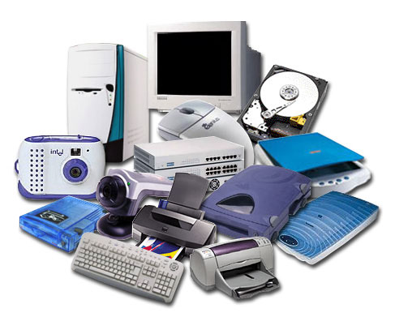
System
Software
Program
code
code
code
code
Data

Slide 19
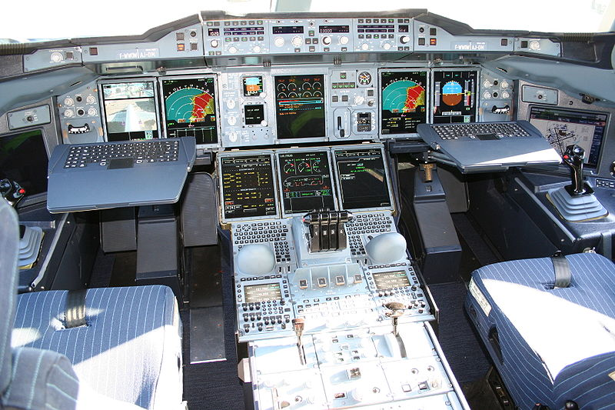
Developing software is a hard job
  The system can be big and complex
  You need to interact with different people who care about different things
Organisation manager: risks, time, cost
Team mate: good style codes, versions
Customer service: usability
Users: user interface
Stakeholders
Airbus A380 cockpit
Dr Roopak Sinha

Slide 20

If you are writing a program for yourself, you will be the ONLY developer and maybe no one else will use it
718304: Software Architecture

Slide 21

A professionally developed software system:
  Is often more than a single program => work with other programmers, software engineers, ...
  Needs to be setup in a particular environment => configurations, installations...
  Users (not the developers) will use/operate it => user interface (interact with users)
  Commercial product => organisation objectives, customer service...
718304: Software Architecture

Slide 22
For success in large software development, it is important to follow an engineering approach, consisting of a well-defined process
“Software engineering is an engineering discipline that is concerned with all aspects of software production.” (Sommerville)
Dr Roopak Sinha

Slide 23
Software development process models
Activities in software development:
  Software specification/requirement engineering: understanding and defining what services are required from the system and identifying the constraints on the system’s operation and development
  Software design and implementation: converting a system specification into an executable system
  Software validation: checking whether the system conforms to its specification (verification), and meets the expectation of the customer (validation)
  Software evolution: developing software initially, then repeatedly updating it for various reasons
Dr Roopak Sinha

Slide 24
Requirements
definition
System design
Implementation
Verification &
validation
Operation &
maintenance
Software process model: a simplified description of a software process. It presents a description of a process from some particular perspective
  Waterfall model
  Spiral model
  V-model
  Agile model
  ...
Dr Roopak Sinha

Slide 25
The Waterfall/V model
System’s services, constraints and goals are established by consultation with users. They are defined in detail and serve as a system specification
Requirements
definition
Establish an overall system architecture; Identify and describe fundamental system abstractions and their relationships
System design
The software design is realised as a set of program units; unit testing involves verifying that each unit meets its specification
Implementation
& unit testing
The individual program units are integrated and tested as a complete system
Integration &
system testing
The system is installed and put into practical use; correcting errors and improving the implementation
Operation &
maintenance
Dr Roopak Sinha

Slide 26
Iterative and incremental development
Iterative: it is a cyclic process
Incremental: the software will be developed incrementally
Define system
deliverables
Specify system
increment
Build system
increment
Validate
increment
Define system
architecture
No
System
Complete?
Deliver final
system
Validate
system
Integrate
increment
Yes
Dr Roopak Sinha
Notes:
Normally, it will take a long time to develop large software systems. Change is unavoidable in large software projects. The system requirements could be changed as the business cases change; As new technologies become available, designs and implementation may also change as well. So, this means, software process is not a one-off process, and the Waterfall model is not handle these dynamics.
To overcome weaknesses of the Waterfall model, people developed the iterative and incremental
It starts with an initial planning and ends with deployment with the cyclic interaction in between.

Slide 27
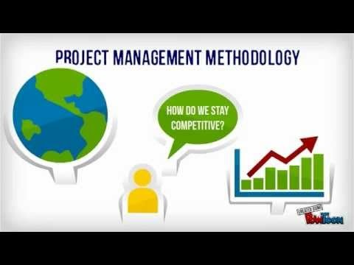
Which Methodology?
718304: Software Architecture

Slide 28
Summary
Software is not just the programs themselves but also all associated documentation and configuration data that is required to make these programs operate correctly
Software engineering is an engineering discipline that is concerned with all aspects of software production
For success in large software development, it is important to follow an engineering approach, consisting of a well-defined process
Activities in software development
Software process and process model
Well known process models: waterfall, agile
  Their principles, advantages and disadvantages
718304: Software Architecture

Slide 29
Reading:
Ian Sommerville, Software engineering, 8th edition, 2007 (Call Number: 005.1 SOM)
Dr Roopak Sinha

Slide 30
Questions?
718304: Software Architecture

